Slide 1
KESFORD
Portfolio
Waterproofing
Coating
Flooring
Expansion Joint
Concrete Repair
Re-roofing

Slide 2
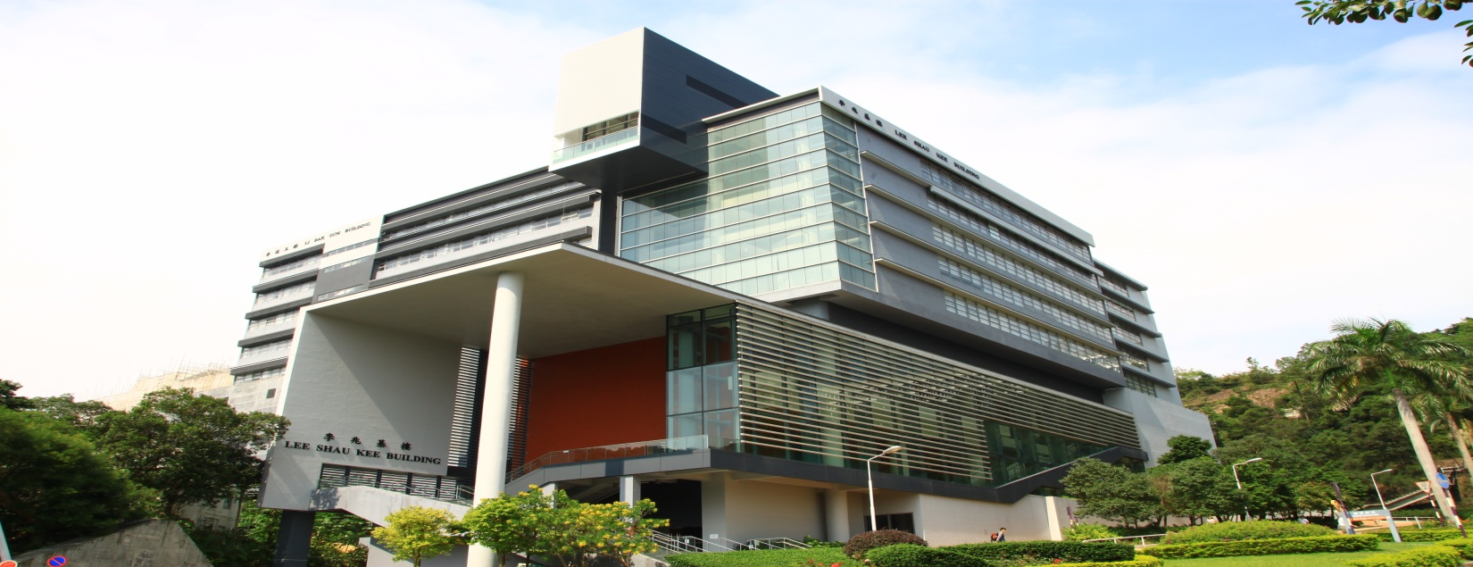

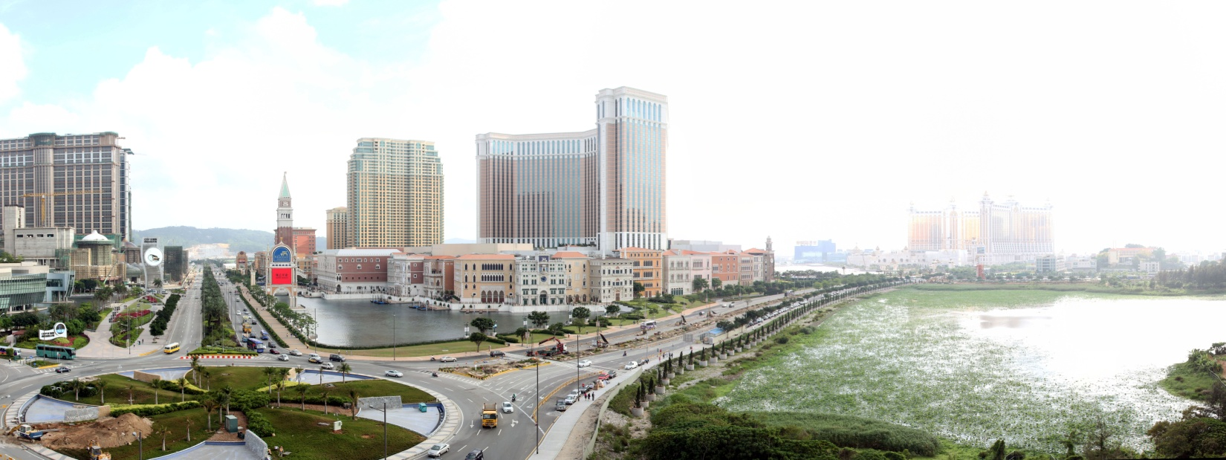
The Company
Kesford (Hong Kong) Ltd. was founded in 2001. Over the years, Kesford has been supplying and applying reputable brands of high-quality construction materials. Through working directly with property developers, consultants and contractors, we have successfully serviced many construction and “design and build” projects in Hong Kong and Macau throughout the years.
Kesford has its own trained, experienced and well equipped contracting team. Our team offers advice on all aspects of product selection and application methods based on various designs, and provides unparalleled solutions to exceed the expectations of our valued customers.
Our clients include both public and private sectors. For the public sector, our clients include Mass Transit Railway Corporation, Hong Kong Housing Authority, Architectural Services Department, Hong Kong Hospital Authority, Airport Authority Hong Kong, Drainage Services Department, Water Supplies Department, Hong Kong Electric, Chinese University Hong Kong, etc. For the private sector, we have clients including Galaxy Entertainment, Hutchison Whampoa Group, Cheung Kong Holdings Ltd., Swire Properties, Tins’, New World Development, etc.

Slide 3
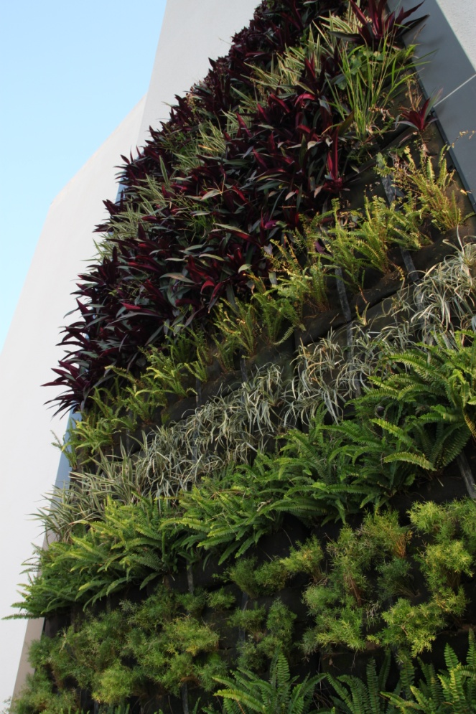
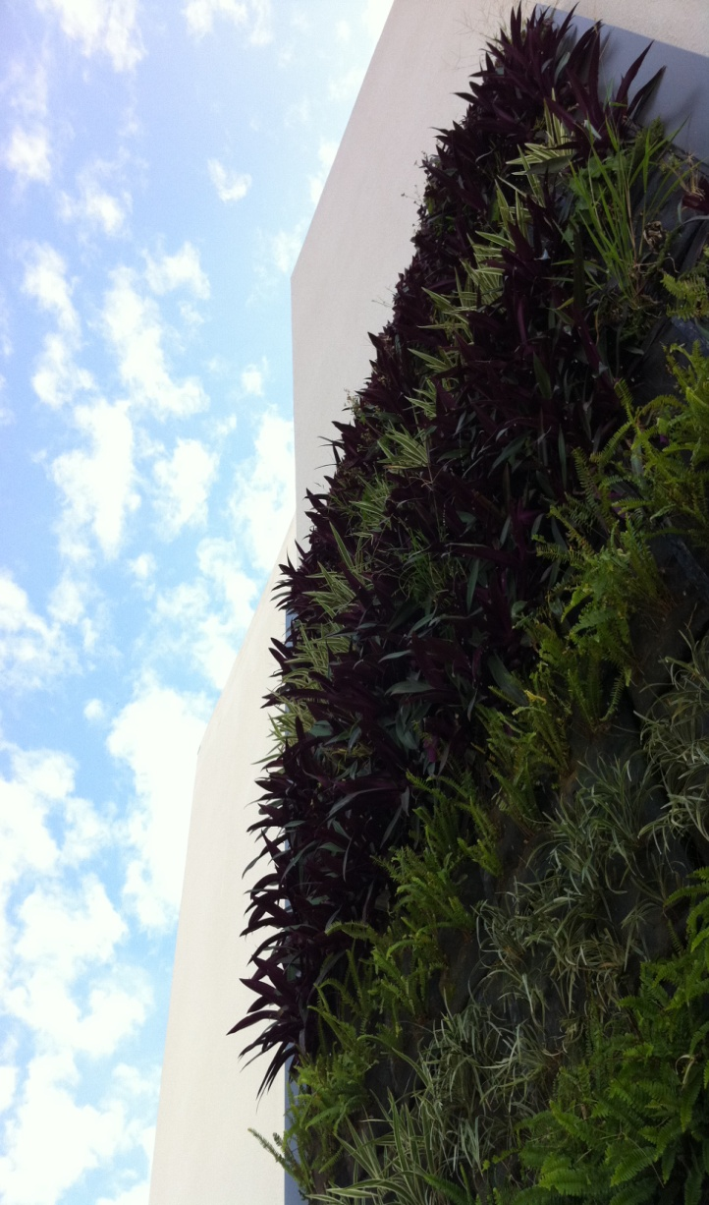
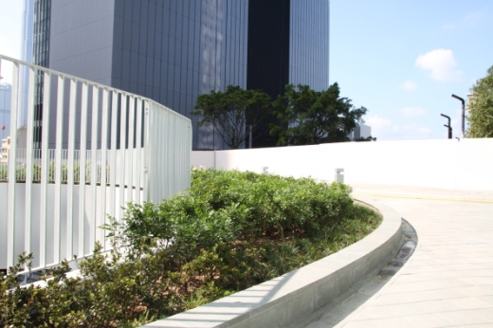
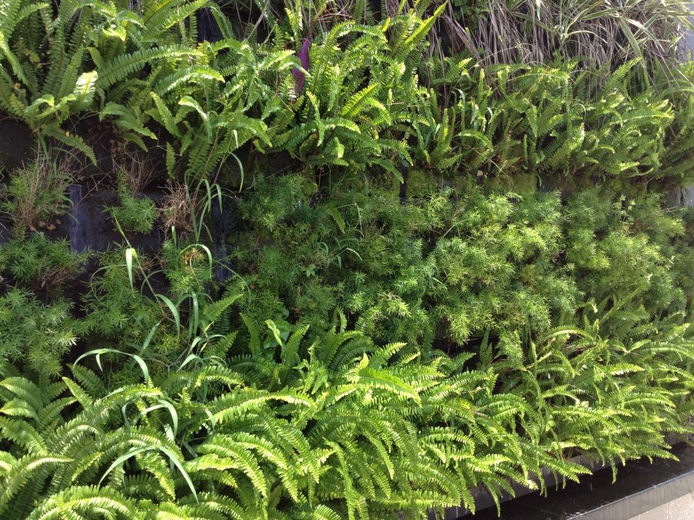
Our Motto
All our contract works are executed with the highest standard in the shortest period of time.
“Offering harmony proposal by fully understand the designers’ idea and building usage ”.
Our Commitment
Safety, Service, Satisfaction, Quality and Environmental Protection have long been the five standards we committed for our products and services.
SAFETY
SERVICE
SATISFACTION
QUALITY
ENVIRONMENT

Slide 4
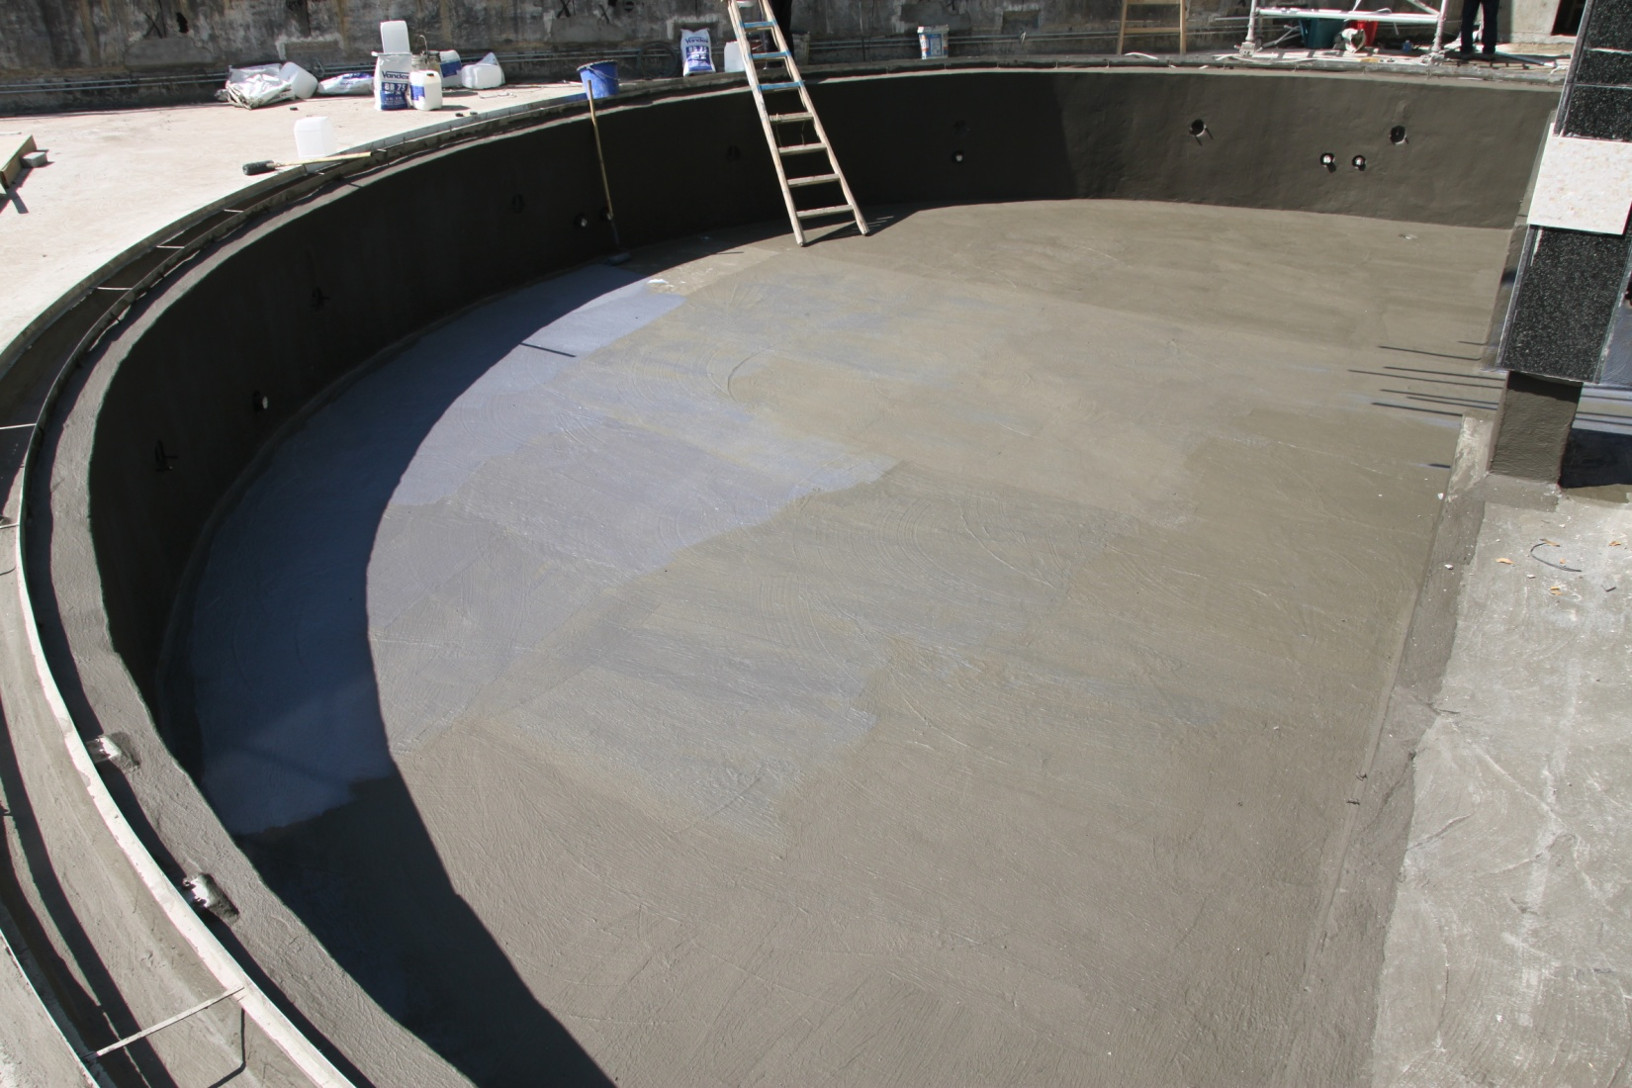
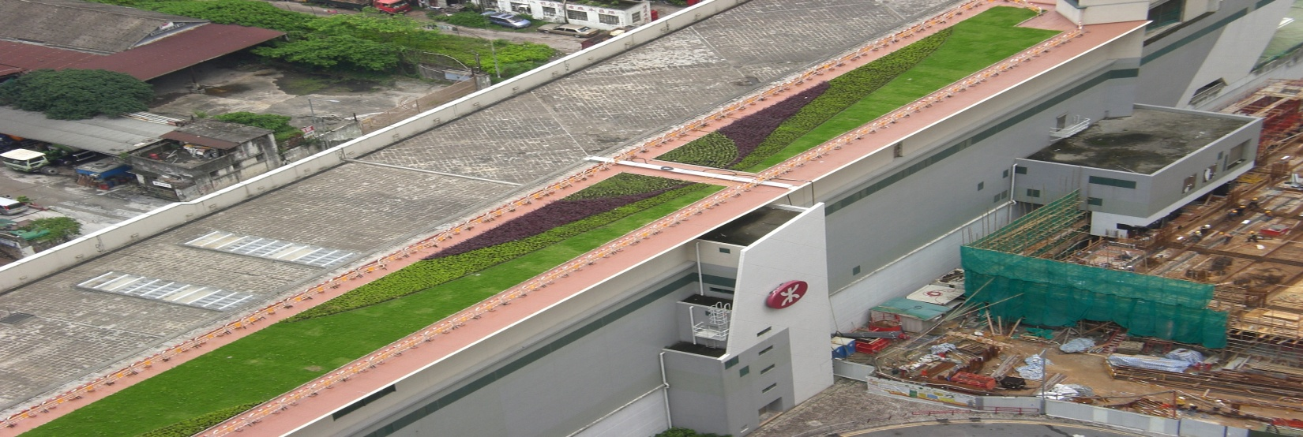
Our Services
Kesford (Hong Kong) Ltd. offers consultation, application, testing technology, guarantee, maintenance and renovation services, specializing in Waterproof, Functional Coating, Garden Roof, Expansion Joints, Flooring, Concrete Repair & Re-roofing System.
Waterproofing
Coating
Flooring
Expansion Joint
Concrete Repair
Re-roofing

Slide 5
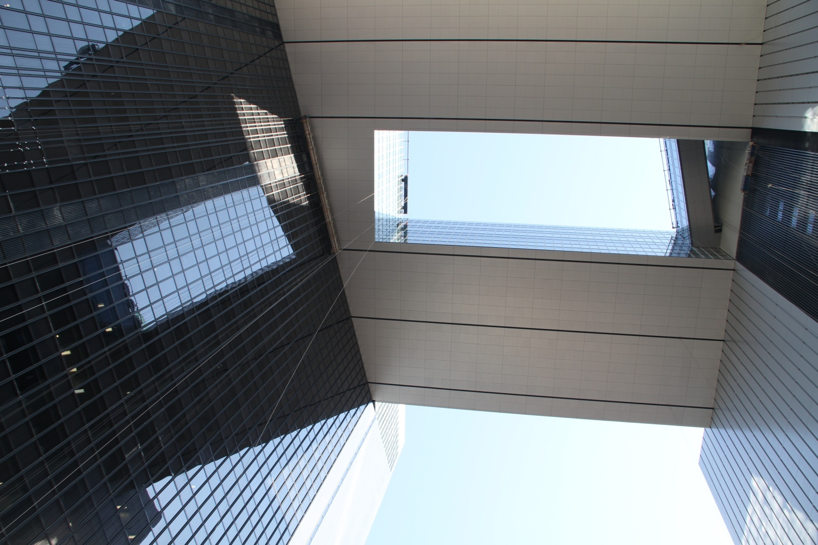
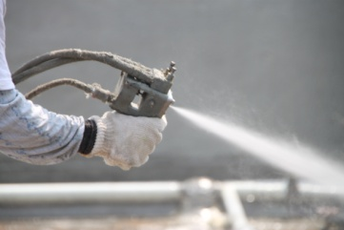
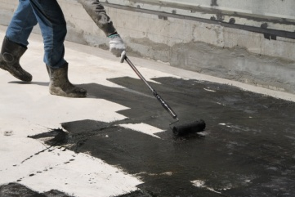
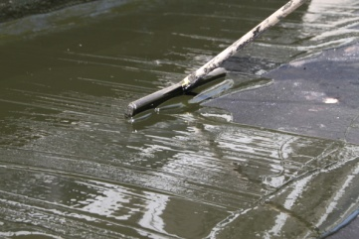
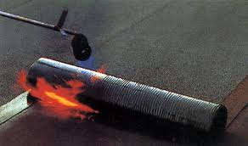
Waterproofing
A SOLID CHOICE
Act for High Quality Waterproofing Materials
Kesford (Hong Kong) Ltd. Is a specialist waterproofing supplier and applicator for construction of basements, tunnels, large commercial and industrial roof, garden roof, swimming pool, water & sewage treatment structure etc. We offer high quality service and innovative products to our clients including different kinds of waterproofing system as below:-
Hydrotech MM6125 – Hot Applied Monolithic Modified Rubberized Asphalt Membrane
Hydrolink Polyurea – Innovative Spray Applied Pure Polyurea Membrane
Hydrolink Penetron – Crystalline Waterproofing Concrete Admixture
Hydrolink Penetron - Capillary Cementitious Waterproofing Slurry &
Hydrolink EW – High Performance Flexible Cementitious Slurry
Hydrolink Elastic Guard PU – Cold Applied Liquid Polyurethene Membrane
Hydrolink Bitumat – Modified Bituminous Self Adhesive & Torch Applied Sheet Membrane
Hydrolink BT – Economic Bituminous Paint Coating
Hydrolink Syn-roof Hi Build – UV Resistance Arcylic Coating
Hydrolink Bentonite – High Effective Bentonite Geotextile Waterproofing
Hydrolink HLT – Hydro- Lock Treatment Coating

Slide 6
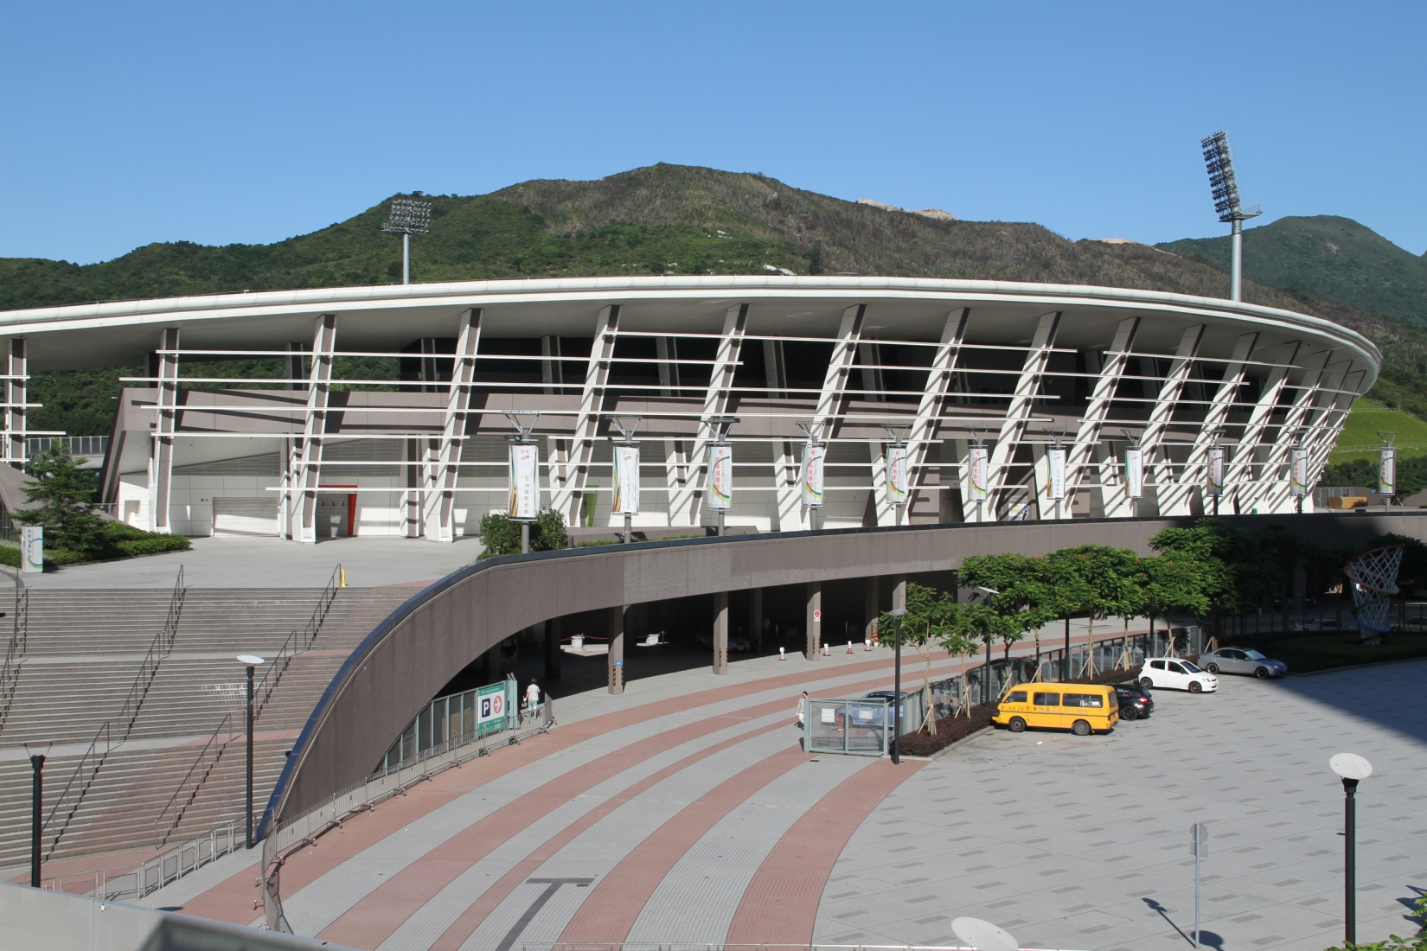

Functional
Coating
Protecting buildings and creating beautiful exteriors with exceptional functional coatings for architectural use .…..
Kesford (Hong Kong) Ltd. continue to search for and provide a range of creative, innovative, special, high performance and environmental friendly coating systems in Architectural, Decorative, Anti-Graffiti & Industrial Coating including:-
“Hydron” Anti-Graffiti Coating
“Hydron” Graffiti Remover
“Hydron” Stone Cleaner
“Hydron” Protective Coating
“Hydron” Anti-Carbonation Coating

Slide 7
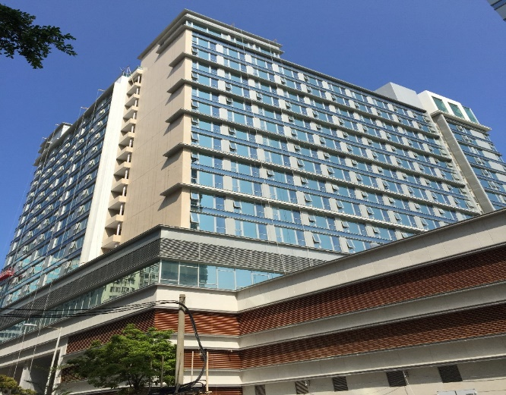
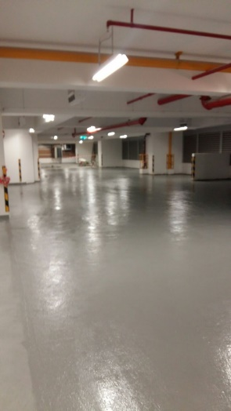
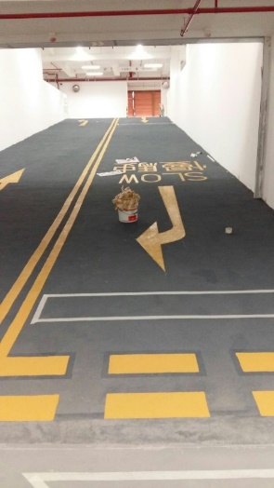
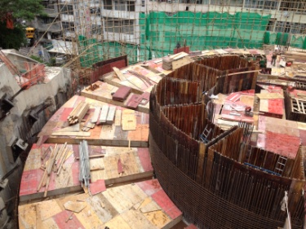
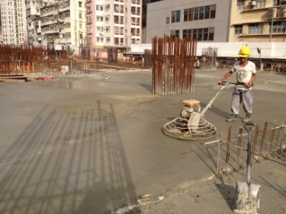
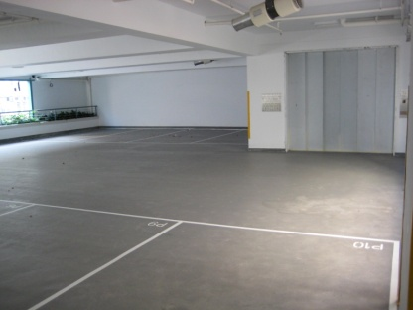
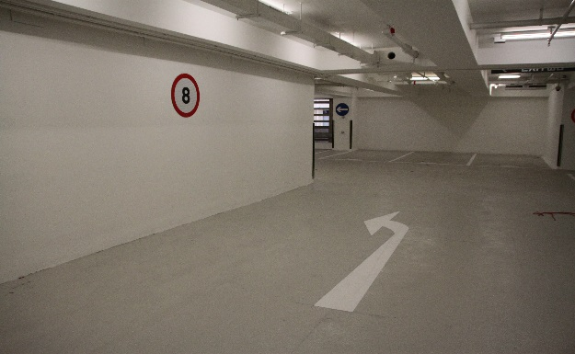
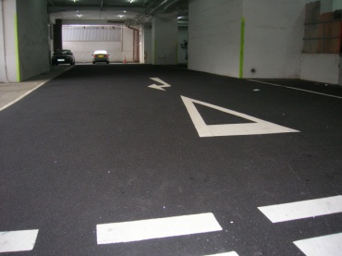
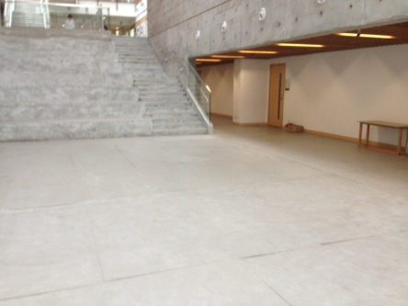
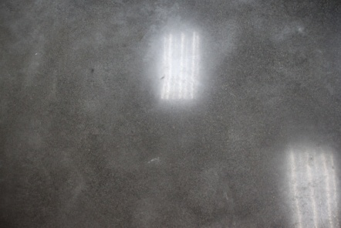
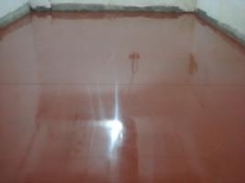
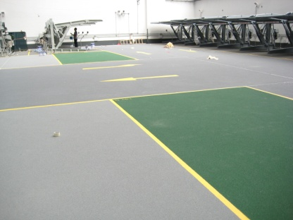
Flooring
Functional, Durable & Decorative Flooring System
Architectural Expansion Joint
Kesford (Hong Kong) Ltd. is specialized in flooring works such as dry shake hardener, self-leveling epoxy flooring, self-smoothing floor screed, polyurea, polyurethane and epoxy floor coating, road surface anti-skid system and liquid hardener. Kesford is experienced in the epoxy flooring business and is supported by a lot of practical job experience. Kesford offers a wide choices of systems, thickness, colours and textures to suit all your flooring needs. All materials are supplied by renowned manufacturers both locally and in Germany, United State and European Community.
“Hydrolink Penetron Plus” Monolithic Waterproofing
& Floor Hardener
“Hydrolink” Durable Polyurea Floor Coating
“Hydrolink” Flexible & Waterproof Polyurethane Floor Coating
“Hydrolink” Heavy Duty Epoxy Floor Coating
“Hydrolink” High Skid Resistance Floor System
“Hydrolink” Over layment / Underlayment Self Leveling
“Hydrolink – Peneseal FH” Liquid Hardener / Densifiers
Perfect flooring solutions for all industries……..

Slide 8
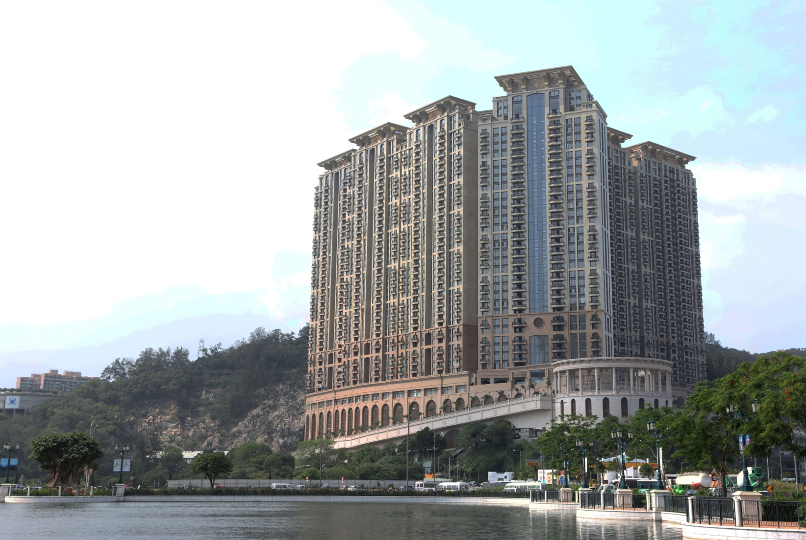
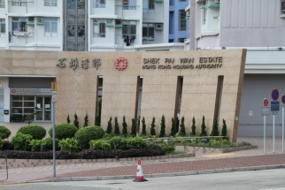
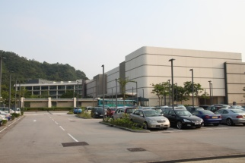
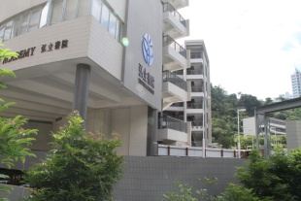
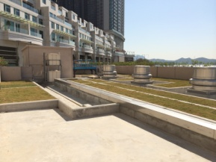
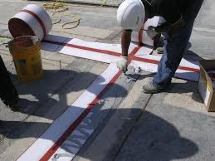
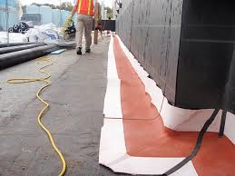
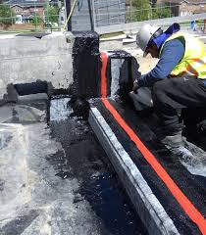
Expansion
Joints
Architectural Expansion Joint
Architectural Expansion Joint Cover
A new way of design…
A fully integrated and complete joint system…
An elegant appearance that nowhere else can offer!
Heavy Duty Expansion Joint Membrane
Monolithic and elastic seamed joints ,
Durable Membrane
High Tensile Strength & Abrasion Resistance……
Proprietary Expansion Joint Fire Barrier
Blanket type fire-barrier to prevent transmission
of smoke and flame……

Slide 9
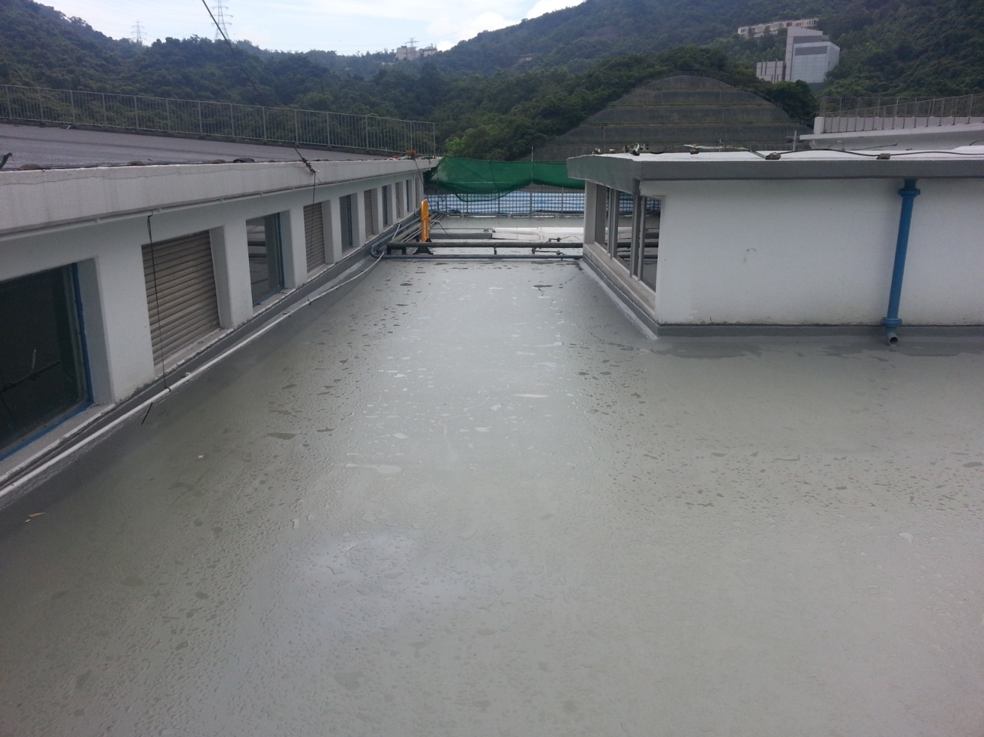
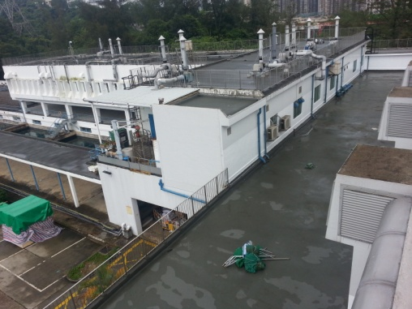
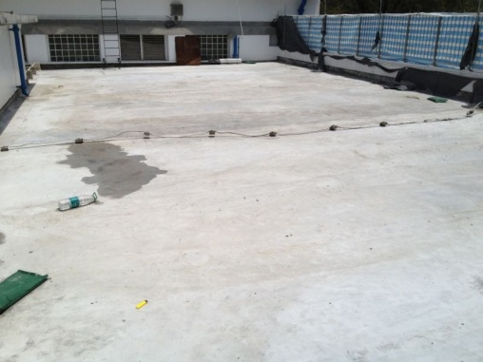
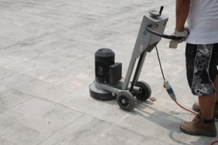
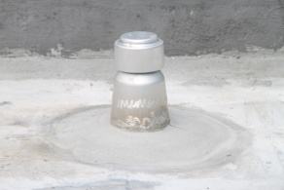
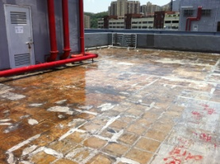
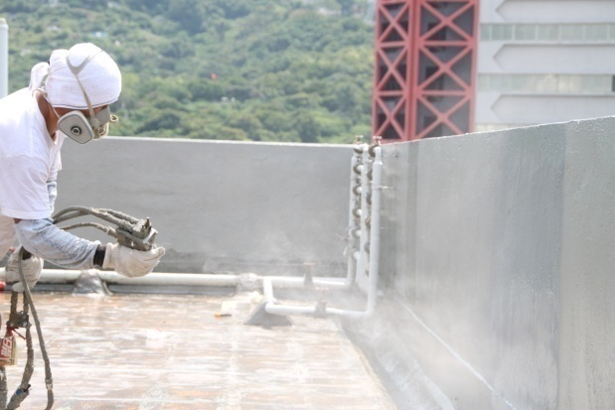
RE-ROOFING
ECO-FRIENDLY RE-ROOFING SYSTEM
Kesford (Hong Kong) Ltd. provides an one-stop service for all types of re-roofing works as well as conventional or Eco-Friendly re-roofing system. Over the time, Kesford has completed over 100,000s.m. of re-roofing work for the government and private projects.
For environmental protection, we develop an Eco-Friendly Polyurea Re-roofing System which lends itself well to all types of roofing situations, from traditional flat roofs to unusual designs. Eco-Polyurea Re-roofing Systems can be applied rapidly, with no disruption to the facilities. For most re-roofing situations, the existing roof finishes can still be preserved in order to lower the disturbance.
ECO-FRIENDLY POLYUREA RE-ROOFING SYSTEM
No need to remove the existing roof finish
No disruption to the facilities
Eco-friendly
Rapid application
Cost saving
Waterproof & Suitable For Garden Roof
Easy maintenance

Slide 10
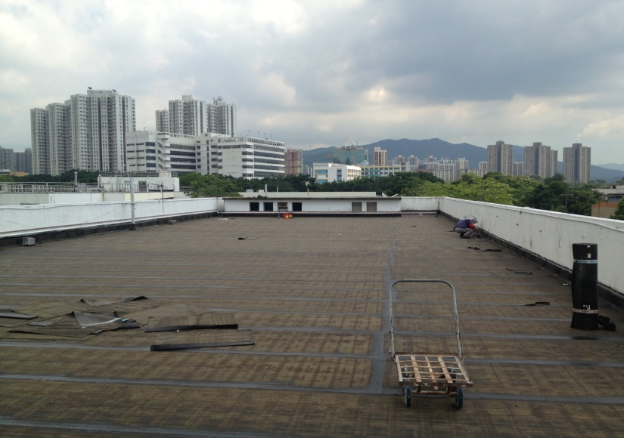
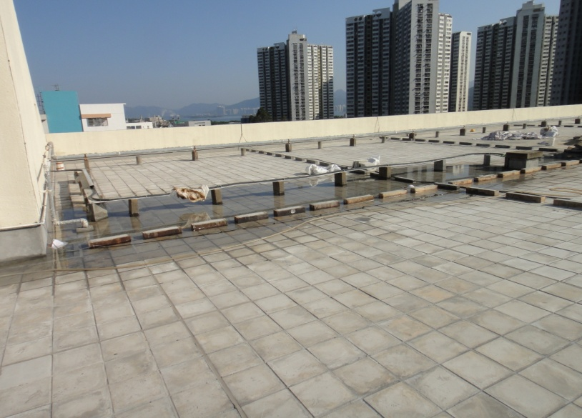
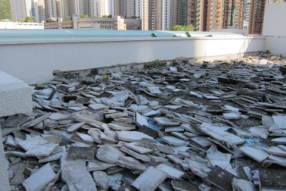
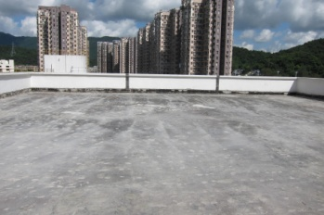
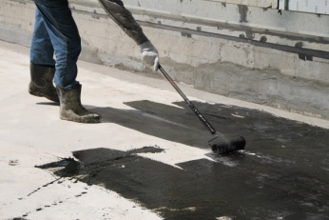
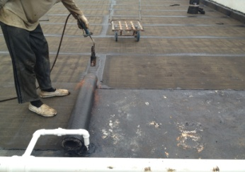
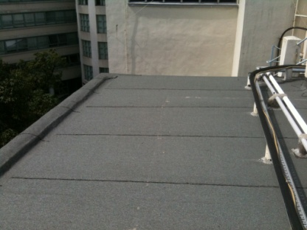

Conventional Re-Roofing
RE-ROOFING
KESFORD has carried out the re-roofing works for ASD (PSB) Department & Education Bureau Term Contracts since 2008 and completed over 200,000s.m. re-roofing works for different term contractors of Hong Kong Island Eastern, Wanchi, Kowloon Mid & West, Kwai Chung, Tsing Yi, Tsuen Wan, Shatin, Tai Po & North District including Able Engineering Co. Ltd., China Resources Construction Co. Ltd., K-peak Co. Ltd., Square Construction Co. Ltd. & Lanon Construction Co. Ltd.
Selected Job References
Maintenance Term Contract
Contract No. TCT 031
Contract no TCT041
Contract No. TCW 081
Contract No. TCW 082
Contract No. TCY 073
Contract No. TCW 022
Contract No. TCW 052
Contract No. TCW 042
Architectural Services Department

Slide 11

Kesford
Reference
Waterproofing
Coating
Flooring
Expansion Joint
Concrete Repair
Re-roofing

Slide 12
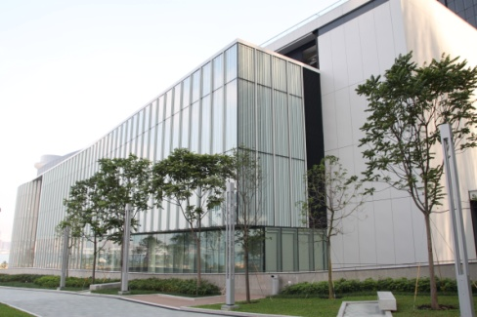
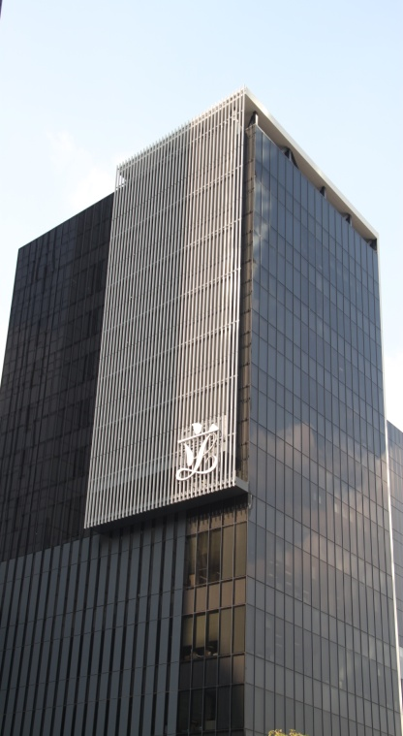




PROJECT REFERENCE
Waterproofing
Architectural Services Department
GAMMON HIP HING JV I TAMAR DEVELOPMENT
Project
The impressive Central Government Complex Tamar is the new location of the offices of the Government of Hong Kong Special Administrative Region. The 42,000s.m plot is among the most prestigious and most expensive ones in Hong Kong.
The project uses neither Chinese nor European government building design, but instead it is a mix of postmodern architecture and low-frills international design. The building’s multistory underground car park and facility quarters reaching deep into groundwater, thus required reliable waterproofing.
Solution
Kesford had completed over 100,000s.m. waterproofing works for all podiums, flat roofs, water tanks, lift pit, external wall and internal wet areas. And our spray applied polyurea membrane was also applied onto the garden roof of a link bridge surface.

Slide 13







PROJECT REFERENCE
Waterproofing
Drainage Services Department
The Government of the Hong Kong Special Administrative Region
Harbour Areas Treatment Scheme Stage 2A Upgrading Works at Stonecutters Island Sewage Treatment Works
Consultant : AECOM
Contractor : Sun Fook Kong – Biwater Joint Venture
Client : Drainage Services Department
Product: Nukote HT Polyurea
Hydrolink Elastic Guard PU

Slide 14






PROJECT REFERENCE
Waterproofing
Water Supplies Department
The Government of the Hong Kong Special Administrative Region
CONTRACT NO. 10/WSD/09
SALT WATER SUPPLY SYSTEM FOR POK FU LAM
Consultant : ARUP
Contractor : Law Chi Yip Construction Co. Ltd.
Client : Water Supplies Department
Product: i) Polyurea Expansion Joint System
ii) Hydrolink Elastic Guard PU Membrane
Selected Job References
Cha Kwo Ling Salt Water Pumping Station
Shatin Water Treatment Plant
Ho Chung Pumping Station
Long Keng Pumping Station
Tai Mong Tsai Pumping Station

Slide 15



PROJECT REFERENCES
PROJECT REFERENCE
Waterproofing
Institutional
HONG KONG SCIENCE PARK PHASE 3A & 3B
GAMMON CONSTRUCTION LTD.
The Hong Kong Science Park Phases 3a and 3b project includes the construction of three 8 to 9-storey Research and Development Office and Laboratory Buildings with basement car parks, service tunnels and a link bridge between buildings, covering a construction floor area of 105,000 s.m.

Slide 16






PROJECT REFERENCES
PROJECT REFERENCE
Waterproofing
Galaxy Phase2, Macau
Casino, Hotel & Resort Development
Macau
BASEMENT, PODIUM & ROOF
KESFORD was awarded the waterproofing contract for Galaxy Phase 2 Macau project in 2012. Our polyurea waterproofing system has been applied onto the external tanking of basement and the total waterproofing areas are over 95,000s.m.
KESFORD Polyurea System was chosen as the waterproofing membrane in this high profile job after thorough pre qualification by the Client and Consultant. The project was complicated; consists of new basement structure with backfill wall & blind-side wall, interfacing between new and existing structure or advance basement structure and also waterproofing for expansion joint.
The specified Polyurea membrane was applied to the basement concrete floor and wall surface treated with epoxy primer or over the geotextile layer to the blind-side surface and expansion joint with filler board.
GALAXY PHASE2, MACAU
Client: Galaxy Cotai Project Management
Architect: Wong & Ouyang (H.K.) Ltd.
Area: External Basement Tanking , Podium & Roof

Slide 17





PROJECT REFERENCE
Coating
Sky Pier, Tung Chung
Gammon Construction Ltd.
THEME COATING
PROJECT DESCRIPTION
SkyPier (海天客運碼頭) is a cross-boundary ferry pier in Hong Kong International Airport, Chek Lap Kok, New Territories, Hong Kong. It is operated by Hong Kong International Airport Ferry Terminal Services Limited, a joint venture company of Chu Kong Passenger Transport Co. Ltd. and Shun Tak-China Travel Ship Management Limited. At this pier, passengers abroad can transit from Hong Kong International Airport to piers in the Peal River Delta of Guangdong Province or vice-versa, without immigration and customs clearance through Hong Kong.
Kesford was responsible for supply & install the integrated colour themed plaster coating with a trowelled fine texture to the external façade as well as the installation of low V.O.C. Italian quartz coating for the architectural internal areas of Sky Pier Building.

Slide 18





PROJECT REFERENCE
Anti-Graffiti Coating
Architectural Services Department
Anti-Graffiti Coating Performance Testing in Government Buildings (ArchSD)
5 Proprietary Anti-Graffiti Coating Testing on 5 common types of wall finishing
Testing on different wall finishes
Aluminum Siding
Brick wall
Stone,
Granite
Concrete

Slide 19





PROJECT REFERENCE
Nu-Guard AG4 Graffiti Remover
Architectural Services Department
Application of Nu-Guard AG4 Graffiti Remover
Clean up with water
Before Application
After application of AG4 and clean up with water
TAMAR DEVELOPMENT

Slide 20




PROJECT REFERENCE
Anti-Graffiti Coating
Nu-Guard AG Clear & Colour Anti-Graffiti Coating For Granite Finishes
Nu-Guard AG surface tested with spray paint / sticker
Cleaning by Water
Cleaning by Water Jet
Anti-GRAFFITI & ANTI- FLYPOSTING COATING SYSTEM

Slide 21






PROJECT REFERENCE
Hydron Stone Cleaning & Protective Sealer
HKSKH TKO Church
Clean up with Hydron SS2 Mould or Algae Remover
Clean up with Hydron BC2 Brick Cleaner
Coated with Hydron Nu-Cryl WRS Protective Sealer
Hydron SS2 kills spores of mould and algae and will prevent the growth of new spores for up to 3 years

Slide 22






PROJECT REFERENCE
Flooring System
Caritas Medical Centre Phase 2
Monolithic Waterproofing & Floor Hardener
Heavy Duty Anti-Skid Epoxy Floor Coating
Project Description
Caritas Medical Centre was founded in 1964. It is an acute general hospital with 1,019 beds that provides 24-hour Accident and Emergency Services and a full range of acute, extended care, ambulatory and community medical services for approximately 360,000 people in the northwestern part of Kowloon.
To meet the ever increasing demand and expectation in medical services, Caritas Medical Centre has started a major re-development project which had its phase I completed in 2002 - a 14-storey new block, Wai Shun Block, for accommodating all acute services. Planning for re-development of the rest of the facilities of the hospital (phase II - ambulatory, rehabilitation and supporting services) has been completed in 2014.
Scope of Work
Kesford (Hong Kong) Ltd. was responsible for the supply and installation of over 20,000s.m. of basement tanking, roofing, water tank & internal wet area waterproofing works, as well as the installation of all floor hardener and epoxy self leveling works. We provided the monolithic waterproof & floor hardener system applied by dry shake powder trowel method onto the car park floor and ramp surfaces with over 6,000s.m.
And our Heavy Duty Epoxy Self Level and Anti Skid Flooring System has also been applied to the captioned car park and plant room floor surface with over 10,000s.m.
BASEMENT TANKING * WATERPROOFING * FLOOR HARDENER * FLOOR COATING * SELF-LEVELING

Slide 23



PROJECT REFERENCE
Flooring Coating
Macau Job Reference
澳門南灣湖 A 區 6 號地段
Architect : Chung Wah Nam Association
Contractor : SOC. De Engenharia Soi Kun, LDA
Treated Area: 4,500s.m.

Slide 24





PROJECT REFERENCE
Expansion Joint
Shek Pai Wan Phase 1 & Phase 2
HSBC DATA CENTRE
Tseung Kwan O, Hong Kong
Contractor : Hsin Chong Construction Ltd.
Architect : L & O
Client : HSBC
Treated Area: 1,2000m.r.
Private Independent School At Kong Siu Wan Tsuen
Selected Job References
Tuen Mun Hospital, N.T.
Lei Muk Shue Estate Phase 3
Lei Yue Mun Phase 2
Hammer Hill Road Park, Kowloon
Sands Casino Phase 2, Macau
One Grantai, Taipa Macau
Chai Wan Youth Campus, Hong Kong

Slide 25





PROJECT REFERENCE
Polyurea Re-roofing
Architectural Services Department
GEOTEXTILE + POLYUREA MEMBRANE
Client : Architectural Services Department (PSB)
Contractor : Able Engineering Co. Ltd.
Area: Existing Metal Roof Surface w/ Type AII Sheet Membrane
Treated : 3,000s.m

Slide 26









PROJECT REFERENCE
Polyurea Re-roofing
教育局 EDUCATION BUREAU
Client : Education Bureau
Contractor : Square Construction Co. Ltd.
Area: Existing Roof Surface
Treated : 700s.m
HONG CHI PINEHILL SCHOOL NO.3, TAI PO

Slide 27








PROJECT REFERENCE
Polyurea Re-roofing
Eco Re-roofing System
POLYUREA MEMBRANE
NON-TOXIC & UV-RESISTANCE
SHATIN WATER TREATMENT PLANT
Client : Water Supplies Department
Contractor : Chun Wo Construction & Engineering Co. Ltd.
Area: Existing Roof Surface
Treated : 900s.m
Selected WSD Re-roofing Job References
Ho Chung Water Treatment Pump Room
Sai Kung Tai Mong Tsai Pumping Station
Long Keng Pumping Station

Slide 28

Contact Us
If you have any questions or problems related to building waterproofing, floor and wall coating, re-roofing, concrete repairs or renovation, we can help! We offer a free consultation service so please do not hesitate to contact us and we will try our very best to assist you.
Room 1613, 16/F.,
Tak Fung Industrial Centre,
168 Texaco Road, Tsuen Wan, N.T.
www.kesford.com.hk
info@kesford.com.hk
p: +852 2396 8813
f: +852 2406 7038
Waterproofing
Coating
Flooring
Expansion Joint
Concrete Repair
Re-roofing

