Slide 1
Kesford
Hong Kong Job Reference
Waterproofing
Coating
Flooring
Expansion Joint
Concrete Repair
Re-roofing

Slide 2

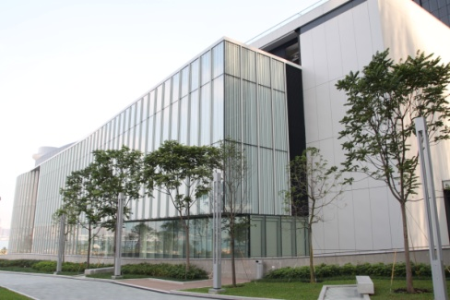
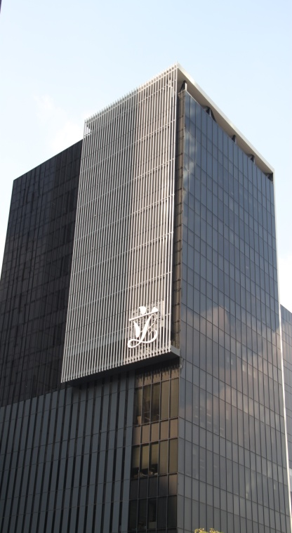
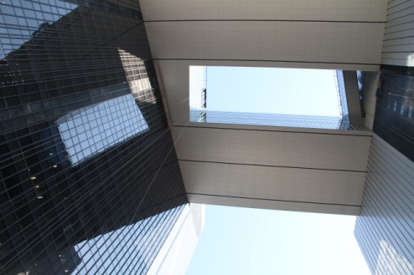
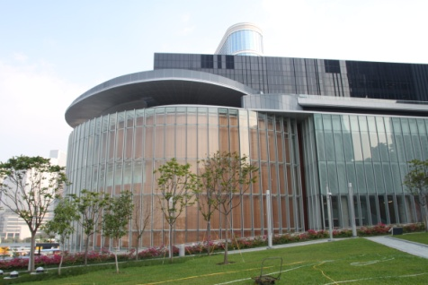
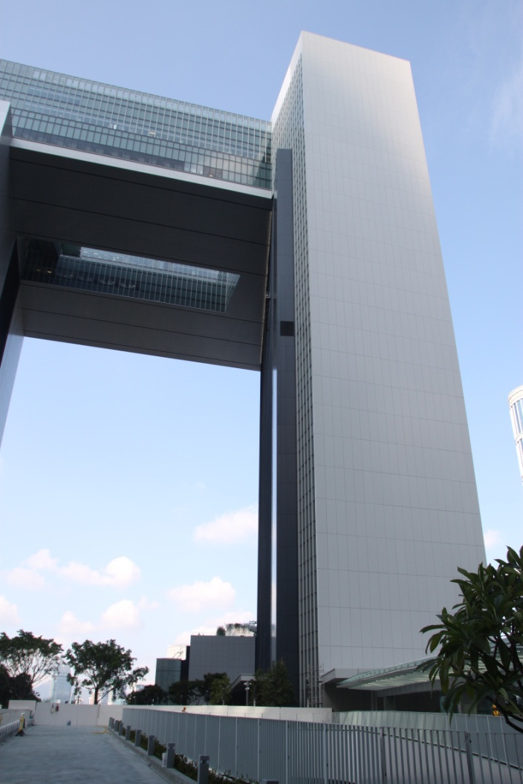
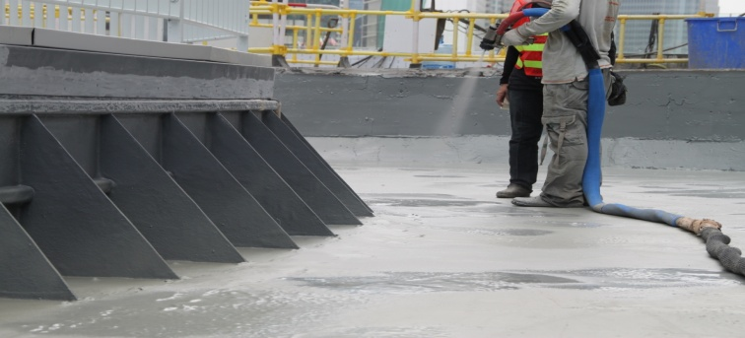
PROJECT REFERENCES
Waterproofing
Architectural Services Department
GAMMON HIP HING JV I TAMAR DEVELOPMENT
Project
The impressive Central Government Complex Tamar is the new location of the offices of the Government of Hong Kong Special Administrative Region. The 42,000s.m plot is among the most prestigious and most expensive ones in Hong Kong.
The project uses neither Chinese nor European government building design, but instead it is a mix of postmodern architecture and low-frills international design. The building’s multistory underground car park and facility quarters reaching deep into groundwater, thus required reliable waterproofing.
Solution
Kesford had completed over 100,000s.m. waterproofing works for all podiums, flat roofs, water tanks, lift pit, external wall and internal wet areas. And our spray applied polyurea membrane was also applied onto the garden roof of a link bridge surface.

Slide 3

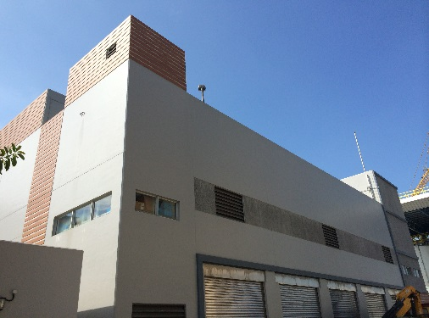
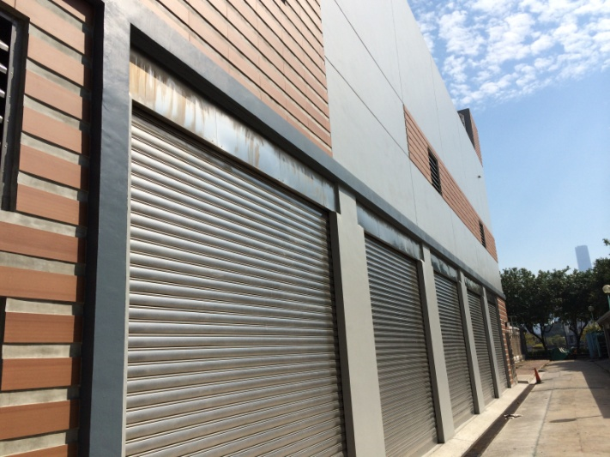
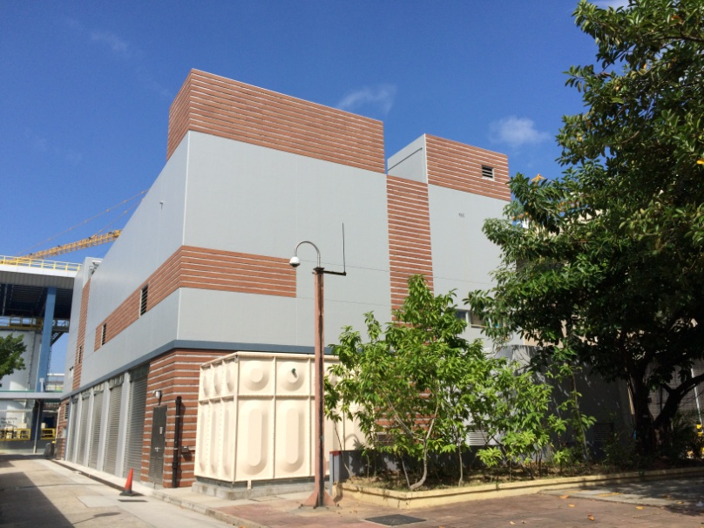
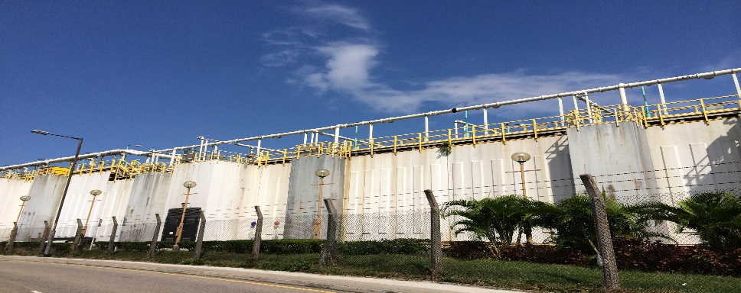
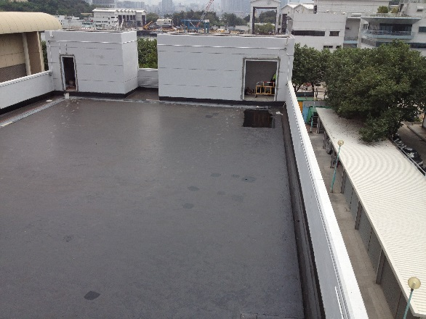
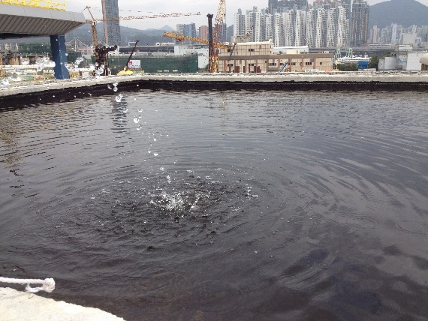
PROJECT REFERENCES
Waterproofing
Drainage Services Department
The Government of the Hong Kong Special Administrative Region
Harbour Areas Treatment Scheme Stage 2A Upgrading Works at Stonecutters Island Sewage Treatment Works
Consultant : AECOM
Contractor : Sun Fook Kong – Biwater Joint Venture
Client : Drainage Services Department
Product: Nukote HT Polyurea
Hydrolink Elastic Guard PU

Slide 4

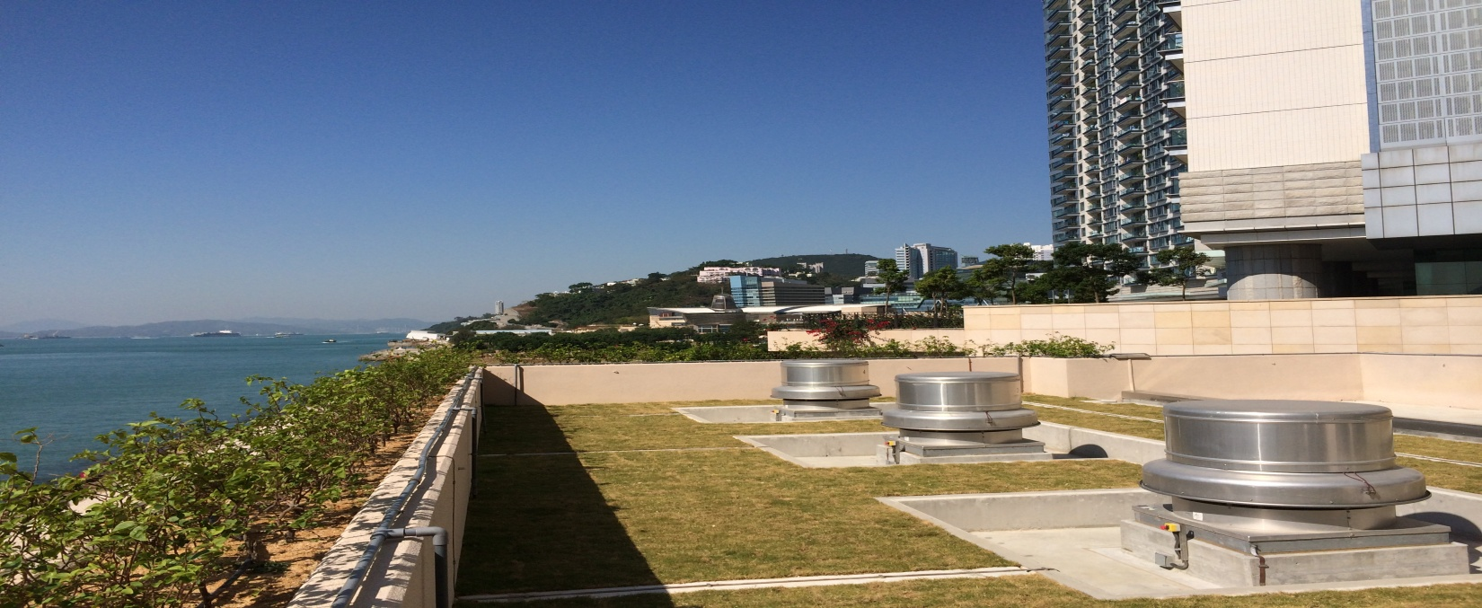
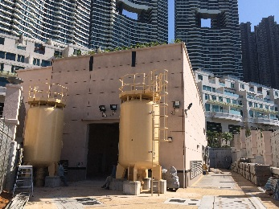
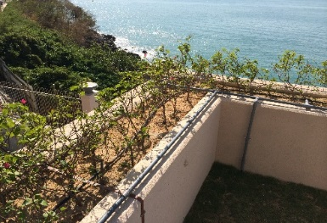
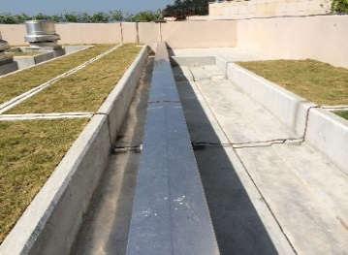
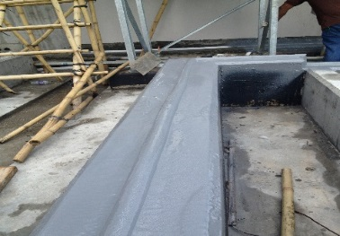

PROJECT REFERENCES
Waterproofing
Water Supplies Department
The Government of the Hong Kong Special Administrative Region
CONTRACT NO. 10/WSD/09
SALT WATER SUPPLY SYSTEM FOR POK FU LAM
Consultant : ARUP
Contractor : Law Chi Yip Construction Co. Ltd.
Client : Water Supplies Department
Product: i) Polyurea Expansion Joint System
ii) Hydrolink Elastic Guard PU Membrane
Selected Job References
Cha Kwo Ling Salt Water Pumping Station
Shatin Water Treatment Plant
Ho Chung Pumping Station
Long Keng Pumping Station
Tai Mong Tsai Pumping Station

Slide 5
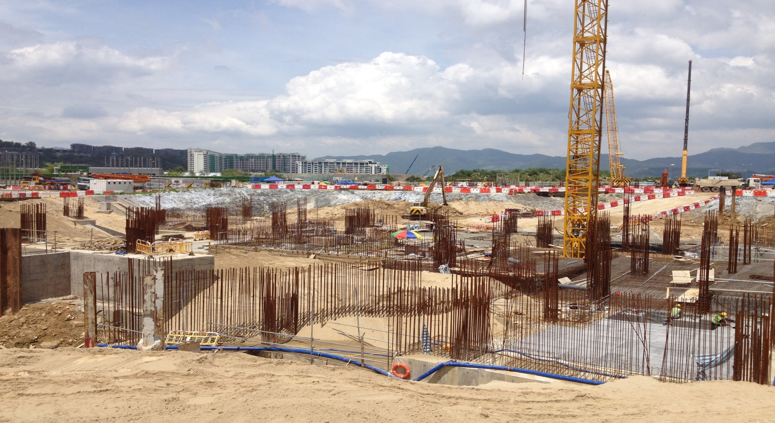
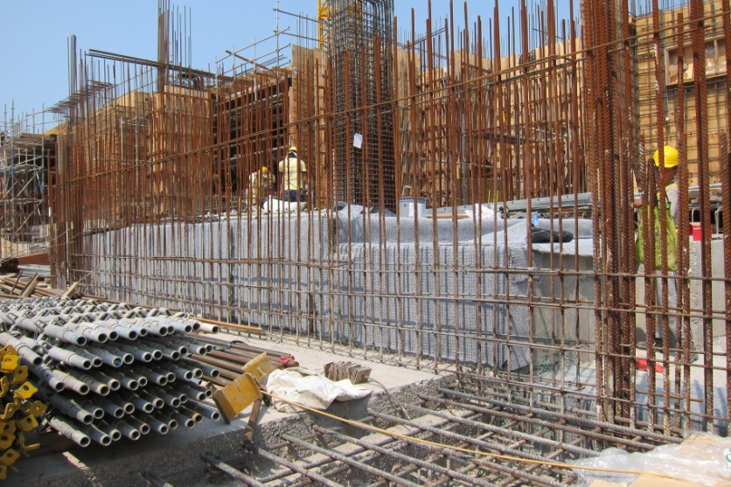
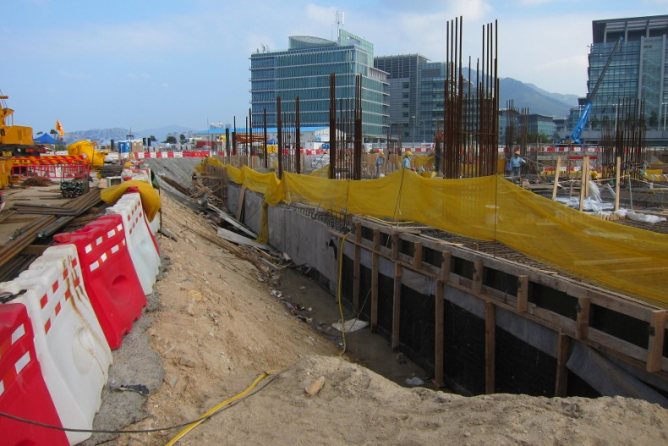
PROJECT REFERENCES
Waterproofing
Institutional
HONG KONG SCIENCE PARK PHASE 3A & 3B
GAMMON CONSTRUCTION LTD.
The Hong Kong Science Park Phases 3a and 3b project includes the construction of three 8 to 9-storey Research and Development Office and Laboratory Buildings with basement car parks, service tunnels and a link bridge between buildings, covering a construction floor area of 105,000 s.m.

Slide 6
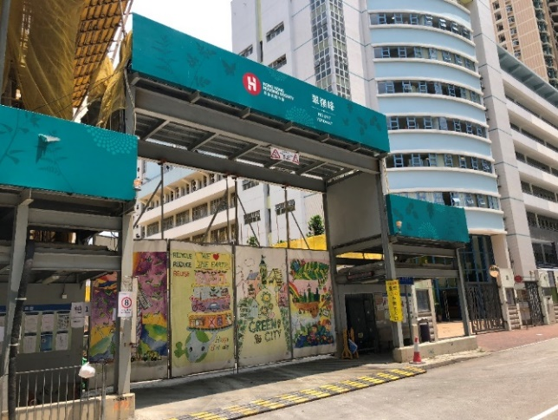
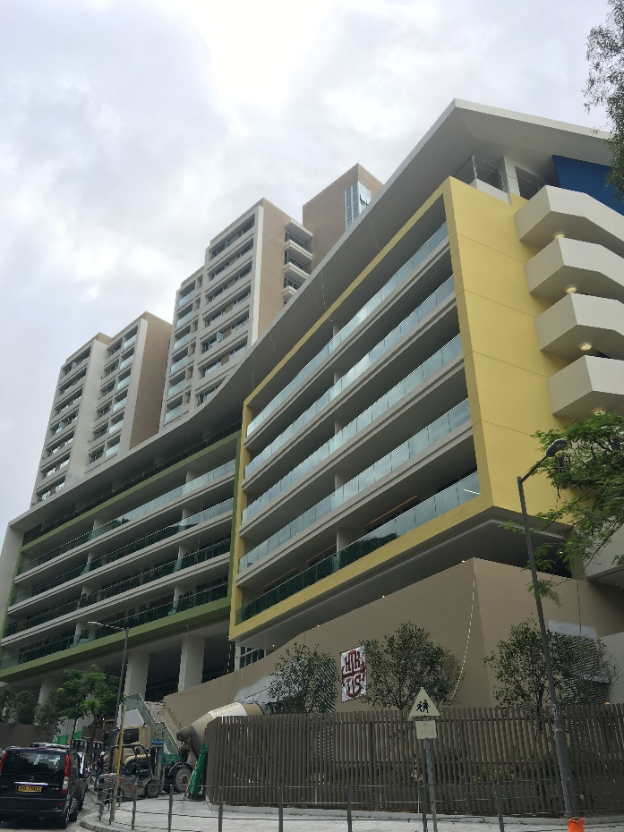
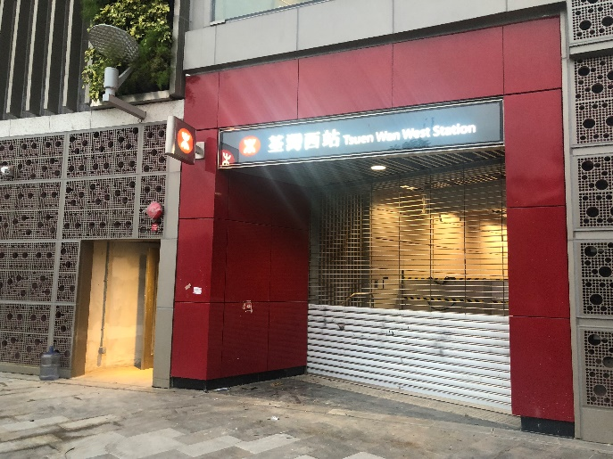
PROJECT REFERENCES
Concrete Repair & Crack Injection
Subsidized Sales Flat Project At Tseung Kwan O Area 73A, Tseung Kwan O, Hong Kong
Client : Hong Kong Housing Socity
Architect : DLN
Treated Area: Concrete Wall & Ceiling
Hong Kong International School At Repulse bay
Selected Job References
HKHA - Pak Tin Phase 7 & 8
HKHS – Ming Wah Dai Ha Re-development
MTRC – Tsuen Wan West Rail Station Development
Phase 5
Ng Fong Street Commercial Building Development
Tuen Mun 541 Residential Development
Sky City Hotel, Hong Kong Air Port
Westland Center, Quarry Bay, Hong Kong
Tsuen Wan West Rail Station
Chai Wan Youth Campus, Hong Kong

Slide 7
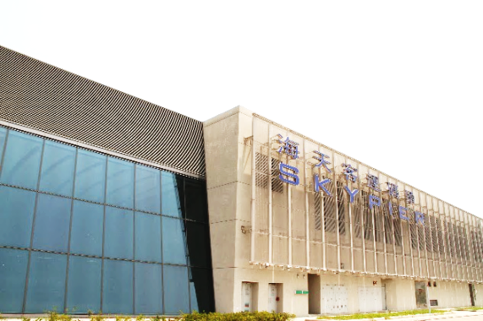
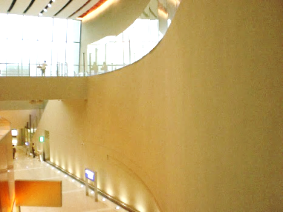
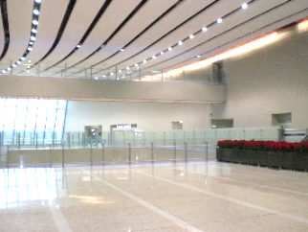
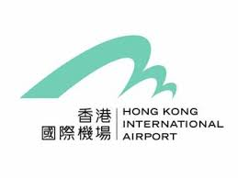
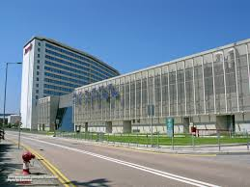
PROJECT REFERENCES
Coating
Sky Pier, Tung Chung
Gammon Construction Ltd.
THEME COATING
PROJECT DESCRIPTION
SkyPier (海天客運碼頭) is a cross-boundary ferry pier in Hong Kong International Airport, Chek Lap Kok, New Territories, Hong Kong. It is operated by Hong Kong International Airport Ferry Terminal Services Limited, a joint venture company of Chu Kong Passenger Transport Co. Ltd. and Shun Tak-China Travel Ship Management Limited. At this pier, passengers abroad can transit from Hong Kong International Airport to piers in the Peal River Delta of Guangdong Province or vice-versa, without immigration and customs clearance through Hong Kong.
Kesford was responsible for supply & install the integrated colour themed plaster coating with a trowelled fine texture to the external façade as well as the installation of low V.O.C. Italian quartz coating for the architectural internal areas of Sky Pier Building.

Slide 8
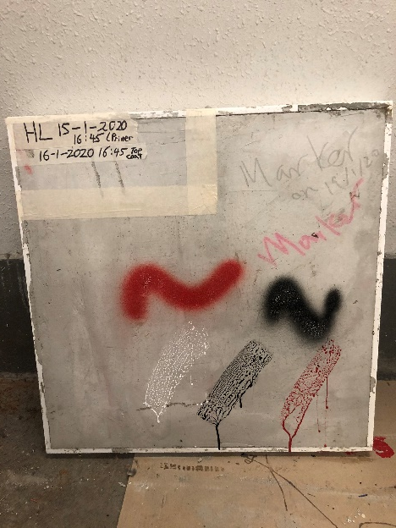
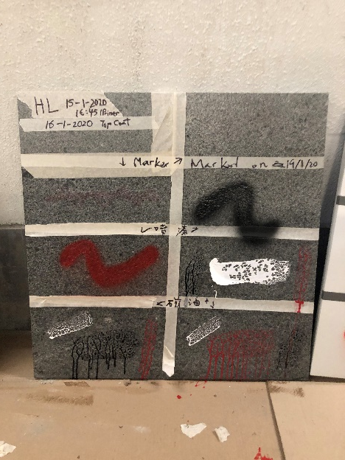
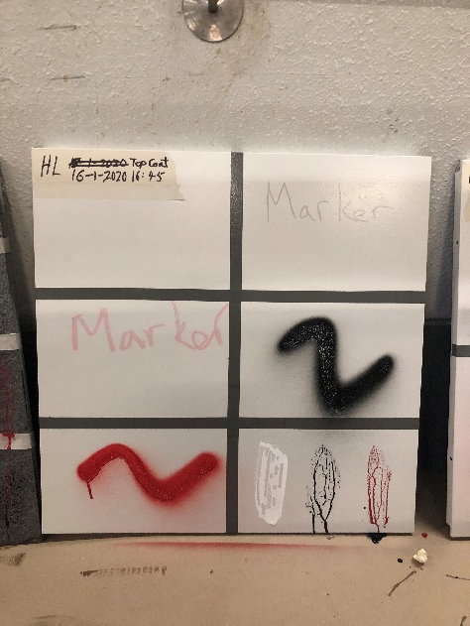
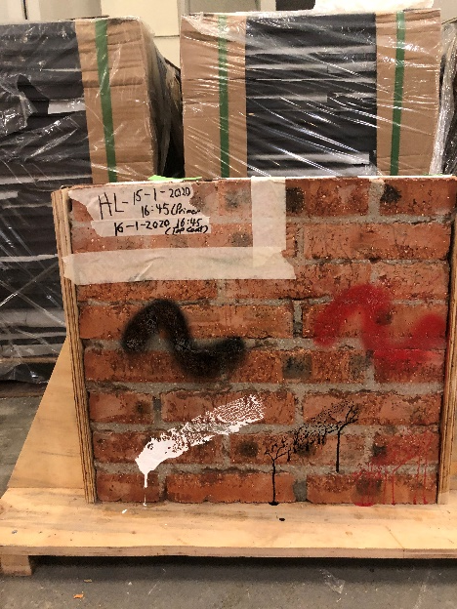
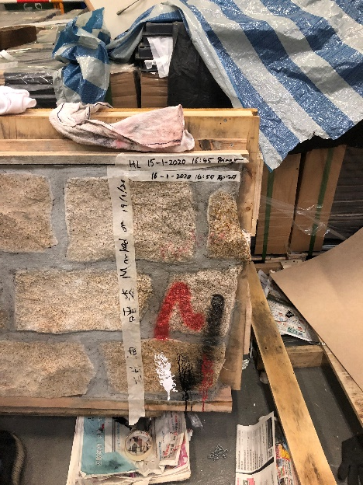
PROJECT REFERENCES
Coating
Architectural Services Department
PROTECTIVE COATING
5 Proprietary Anti-Graffiti Coating Testing on 5 common types of wall finishing
Anti-Graffiti Coating Performance Testing in Government Buildings (ArchSD)
Testing on different wall finishes
Aluminum Siding
Brick wall
Stone,
Granite
Concrete
Anti-Graffiti Coating

Slide 9
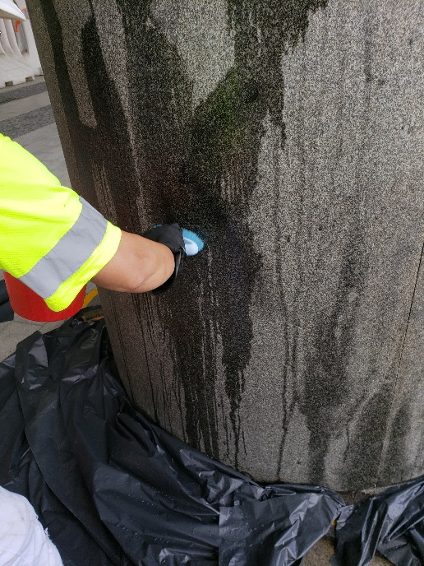
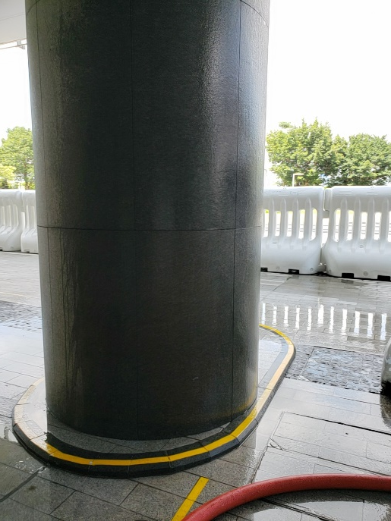
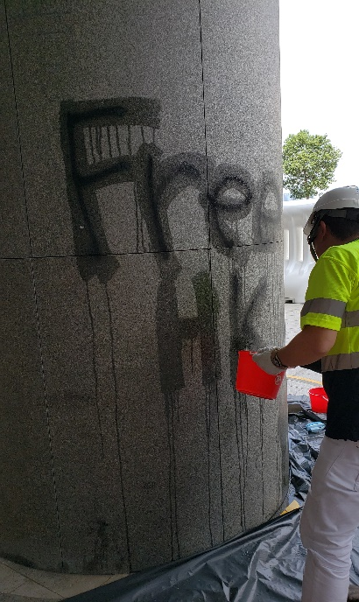
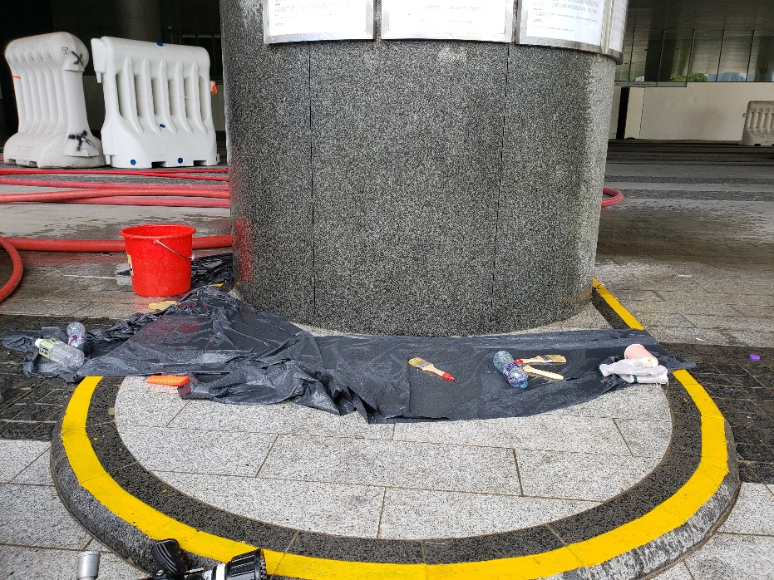
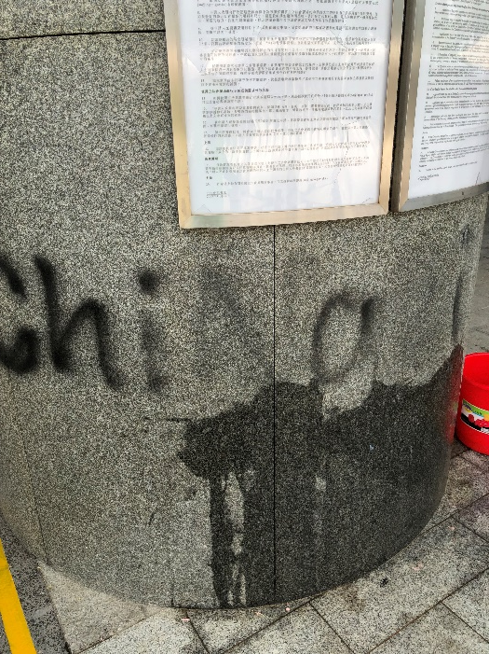
PROJECT REFERENCES
Coating
Architectural Services Department
GRAFFITI REMOVER
Application of Nu-Guard AG4 Graffiti Remover
Clean up with water
Before Application
After application of AG4 and clean up with water
TAMAR DEVELOPMENT
Nu-Guard AG4 Graffiti Remover

Slide 10

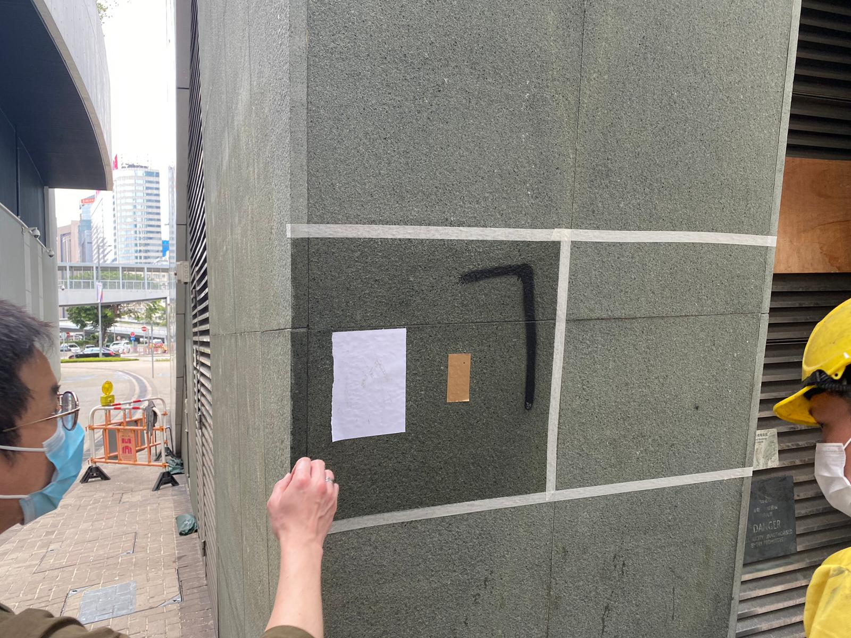
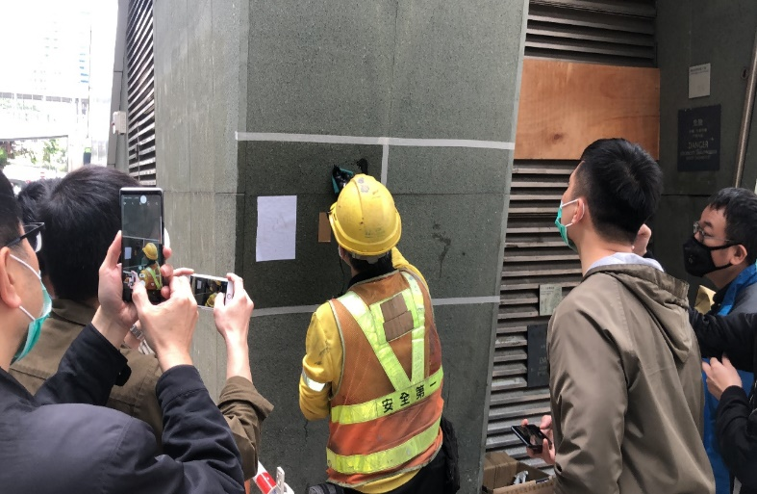
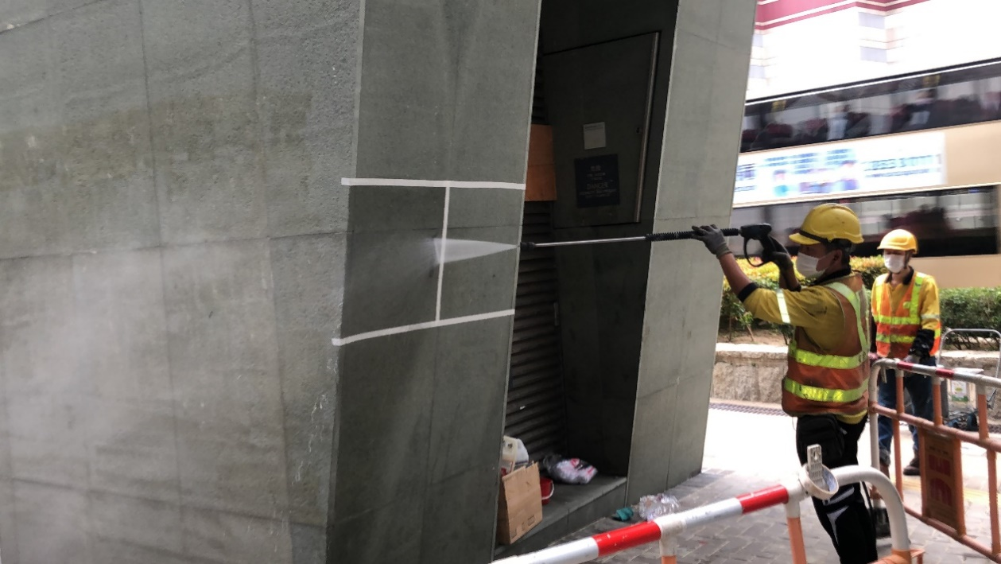
PROJECT REFERENCES
Coating
PROTECTIVE COATING
Nu-Guard AG Clear & Colour Anti-Graffiti Coating For Granite Finishes
Nu-Guard AG surface tested with spray paint / sticker
Cleaning by Water
Cleaning by Water Jet
Anti-GRAFFITI & ANTI- FLYPOSTING COATING SYSTEM

Slide 11
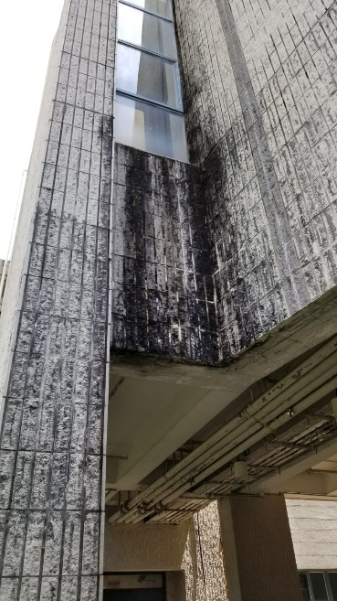
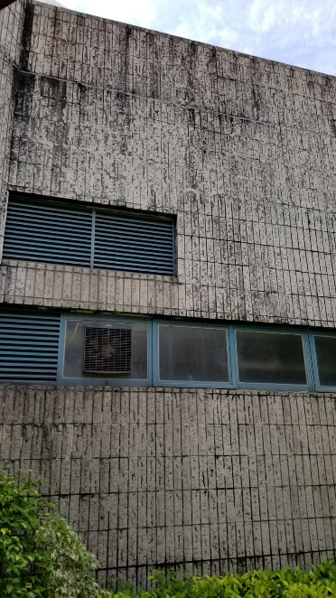

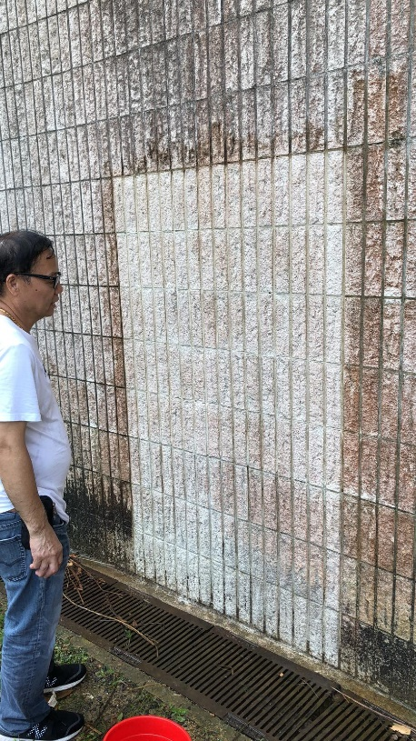
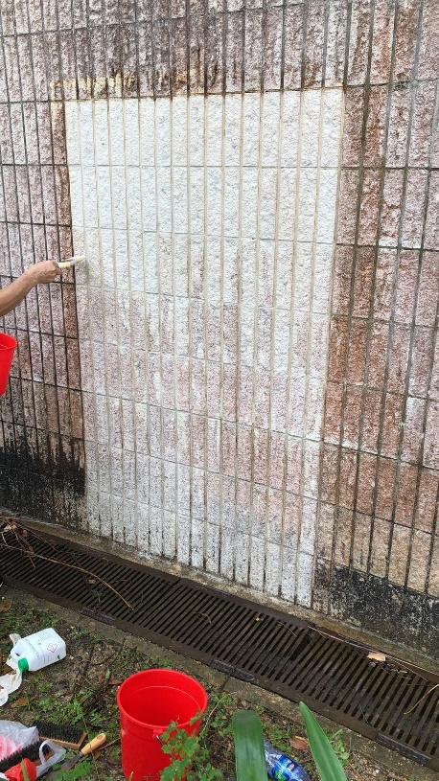
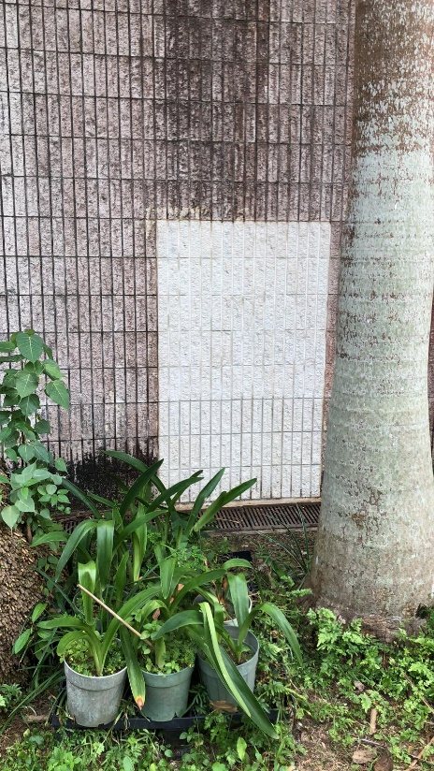
PROJECT REFERENCES
Coating
PROTECTIVE COATING
HKSKH TKO Church
Hydron Stone Cleaning & Protective Sealer
Clean up with Hydron SS2 Mould or Algae Remover
Clean up with Hydron BC2 Brick Cleaner
Coated with Hydron Nu-Cryl WRS Protective Sealer
Hydron SS2 kills spores of mould and algae and will prevent the growth of new spores for up to 3 years

Slide 12
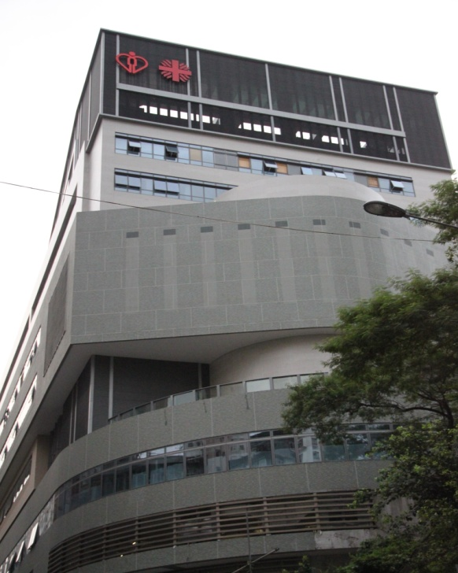
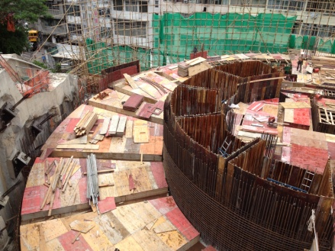
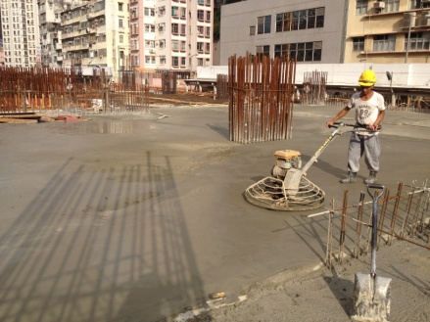
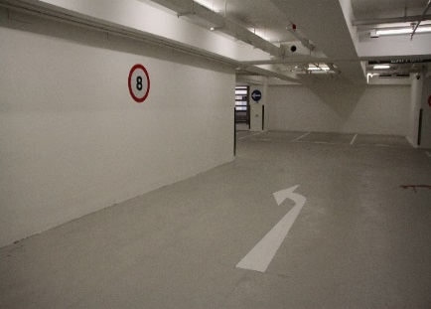



PROJECT REFERENCES
Flooring System
Caritas Medical Centre Phase 2
Monolithic Waterproofing & Floor Hardener
Heavy Duty Anti-Skid Epoxy Floor Coating
Project Description
Caritas Medical Centre was founded in 1964. It is an acute general hospital with 1,019 beds that provides 24-hour Accident and Emergency Services and a full range of acute, extended care, ambulatory and community medical services for approximately 360,000 people in the northwestern part of Kowloon.
To meet the ever increasing demand and expectation in medical services, Caritas Medical Centre has started a major re-development project which had its phase I completed in 2002 - a 14-storey new block, Wai Shun Block, for accommodating all acute services. Planning for re-development of the rest of the facilities of the hospital (phase II - ambulatory, rehabilitation and supporting services) has been completed in 2014.
Scope of Work
Kesford (Hong Kong) Ltd. was responsible for the supply and installation of over 20,000s.m. of basement tanking, roofing, water tank & internal wet area waterproofing works, as well as the installation of all floor hardener and epoxy self leveling works. We provided the monolithic waterproof & floor hardener system applied by dry shake powder trowel method onto the car park floor and ramp surfaces with over 6,000s.m.
And our Heavy Duty Epoxy Self Level and Anti Skid Flooring System has also been applied to the captioned car park and plant room floor surface with over 10,000s.m.
BASEMENT TANKING * WATERPROOFING * FLOOR HARDENER * FLOOR COATING * SELF-LEVELING

Slide 13





PROJECT REFERENCES
Expansion Joint
Shek Pai Wan Phase 1 & Phase 2
HSBC DATA CENTRE
Tseung Kwan O, Hong Kong
Contractor : Hsin Chong Construction Ltd.
Architect : L & O
Client : HSBC
Treated Area: 1,2000m.r.
Private Independent School At Kong Siu Wan Tsuen
Selected Job References
Tuen Mun Hospital, N.T.
Lei Muk Shue Estate Phase 3
Lei Yue Mun Phase 2
Hammer Hill Road Park, Kowloon
Sands Casino Phase 2, Macau
One Grantai, Taipa Macau
Chai Wan Youth Campus, Hong Kong

Slide 14





PROJECT REFERENCES
Re-roofing
Architectural Services Department
GEOTEXTILE + POLYUREA MEMBRANE
Client : Architectural Services Department (PSB)
Contractor : Able Engineering Co. Ltd.
Area: Existing Metal Roof Surface w/ Type AII Sheet Membrane
Treated : 3,000s.m

Slide 15









PROJECT REFERENCES
Re-roofing
教育局 EDUCATION BUREAU
Client : Education Bureau
Contractor : Square Construction Co. Ltd.
Area: Existing Roof Surface
Treated : 700s.m
HONG CHI PINEHILL SCHOOL NO.3, TAI PO

Slide 16








PROJECT REFERENCES
Re-roofing
Eco Re-roofing System
POLYUREA MEMBRANE
NON-TOXIC & UV-RESISTANCE
SHATIN WATER TREATMENT PLANT
Client : Water Supplies Department
Contractor : Chun Wo Construction & Engineering Co. Ltd.
Area: Existing Roof Surface
Treated : 900s.m
Selected WSD Re-roofing Job References
Ho Chung Water Treatment Pump Room
Sai Kung Tai Mong Tsai Pumping Station
Long Keng Pumping Station

Slide 17

Contact Us
If you have any questions or problems related to building waterproofing, floor and wall coating, re-roofing, concrete repairs or renovation, we can help! We offer a free consultation service so please do not hesitate to contact us and we will try our very best to assist you.
Room 1613, 16/F.,
Tak Fung Industrial Centre,
168 Texaco Road, Tsuen Wan, N.T.
www.kesford.com.hk
info@kesford.com.hk
p: +852 2396 8813
f: +852 2406 7038
Waterproofing
Coating
Flooring
Expansion Joint
Concrete Repair
Re-roofing

